Slide 1
Topic Modeling

Slide 2
Topic modeling in NLP seeks to find hidden semantic structure in documents.
Topic modeling provides us with methods to organize, understand and summarize large collections of textual information
It is a probability distribution over collection of words
Documents are again some sort of probability distribution over topics.
There are many techniques that are used to obtain topic models. Latent Dirichlet Allocation (LDA) is a widely used topic modeling technique to extract topic from the textual data.

Slide 3
Topic modeling is a frequently used text-mining tool for discovery of hidden semantic structures in a text body.
Intuitively, given that a document is about a particular topic, one would expect particular words to appear in the document more or less frequently: "dog" and "bone" will appear more often in documents about dogs, "cat" and "meow" will appear in documents about cats, and "the" and "is" will appear equally in both.
A document typically concerns multiple topics in different proportions; thus, in a document that is 10% about cats and 90% about dogs, there would probably be about 9 times more dog words than cat words.
The "topics" produced by topic modeling techniques are clusters of similar words
A topic model captures this intuition in a mathematical framework, which allows examining a set of documents and discovering, based on the statistics of the words in each, what the topics might be

Slide 4
Why Topic Modeling?
Given a corpus and in an unsupervised manner it learns what is the overall topic in what document and so on. No prior annotations . It learns on its own given huge amount of data .
It is a method by which we can organize the various collections by the themes occurring in the document and we can understand, search and do various applications without any prior efforts of manually labelling the data
Discovers the hidden themes that pervade the collection
Annotate the documents according to those themes
Use annotations to organize, summarize and search the texts

Slide 5
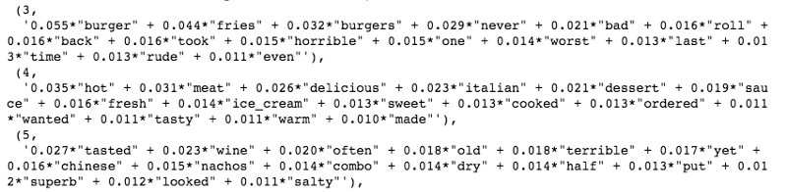
LDA states that each document in a corpus is a combination of a fixed number of topics.
LDA is a way to automatically discover topics from a set of documents
It is described as a method of uncovering hidden structure in a collection of texts
Here are two examples of topics discovered via LDA:
The first topic group for negative burger reviews, and
The second topic group seems to have identified positive Italian restaurant experiences.
The third topic isn’t as clear-cut, but generally seems to touch on terrible, dry salty food.

Slide 6
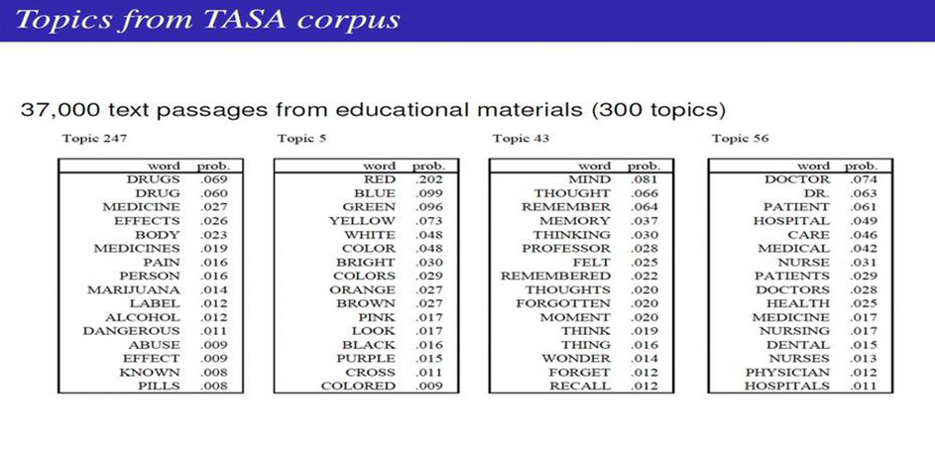
Train LDA model on 37,000 text passages (cleaned and Bigram-ed texts)
Grab the topic distribution for every review using the LDA model

Slide 7
Suppose you have the following set of sentences:
I ate a banana and spinach smoothie for breakfast.
I like to eat broccoli and bananas.
Chinchillas and kittens are cute.
My sister adopted a kitten yesterday.
Look at this cute hamster munching on a piece of broccoli.
Latent Dirichlet allocation is a way of automatically discovering topics that these sentences contain. For example, given these sentences and asked for 2 topics, LDA might produce something like
Sentences 1 and 2: 100% Topic A
Sentences 3 and 4: 100% Topic B
Sentence 5: 60% Topic A, 40% Topic B
Topic A: 30% broccoli, 15% bananas, 10% breakfast, 10% munching, …
Topic B: 20% chinchillas, 20% kittens, 20% cute, 15% hamster, …
It assigns percent values of topics to each sentence to define how relevant is each of the topic to that sentence
You could infer that topic A is a topic about food, and topic B is a topic about cute animals. But LDA does not explicitly identify topics in this manner. All it can do is tell you the probability that specific words are associated with the topic

Slide 8
Why is Topic Modeling useful?
There are several scenarios when topic modeling can prove useful. Here are some of them:
Text classification – Topic modeling can improve classification by grouping similar words together in topics rather than using each word as a feature
Recommender Systems – It is used in recommendation systems engine to recommend users what articles to read based on their reading patterns. It will recommend articles with a topic structure similar to the articles the user has already read.
Uncovering Themes in Texts – Useful for detecting trends in online publications for example

Slide 9
LDA considers documents as being generated by a mixture of the topics.
The purpose of LDA is to compute how much of the document was generated by which topic
LDA is an iterative algorithm. Here are the two main steps:
In the initialization stage, each word is assigned to a random topic.
Iteratively, the algorithm goes through each word and reassigns the word to a topic taking into consideration:
What’s the probability of the word belonging to a topic
What’s the probability of the document to be generated by a topic

Slide 10
LDA pre-processing
Genism library is used to create bi-gram representations of the text
Genism’s LDA implementation needs text as a sparse vector
Remove the most common and the rarest words in the corpus
Genism’s dictionary class will output the word frequency count of each word for each review
Counts the number of occurrences of each distinct word, converts the word to its integer word id and returns the result as a sparse vector

Slide 11
Choosing the Number of Topics for LDA
Run LDA on your corpus with different numbers of topics and see if word distribution per topic looks sensible.
Create a handful of LDA models with different topic values, then see how these perform in the supervised classification model training. This is specific to my goals here, since my ultimate aim is to see if the topic distributions have predictive value.

